Slide 1
Stalking In The US
By Jordan Boone and Jon Almonte

Slide 2
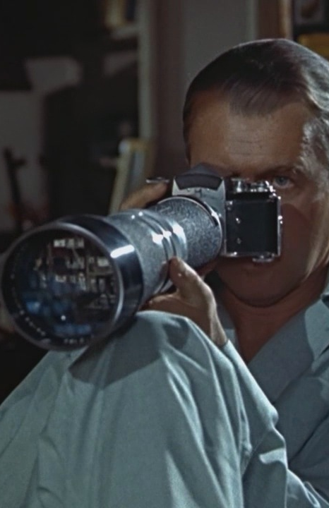
Rear Window Inspiration
Jeff obsessively watched his neighbors
There were many scenes and events that unfolded through the lens of his camera / binoculars
He followed their every move, before finding something that caused him to take action

Slide 3
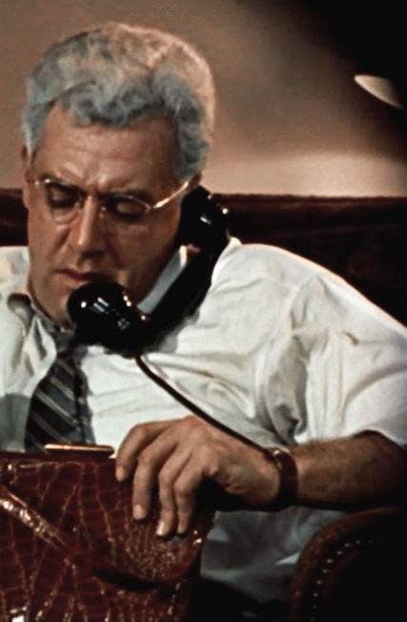
Rear Window Inspiration (cont.)
Thorwald becomes the prime target of his investigations
Jeff becomes emotionally attached to his subject so much that it impacts his own life
Jeff uses what he sees in his neighbor’s windows to form lives, opinions and emotions about them

Slide 4
Outside Inspiration

Slide 5
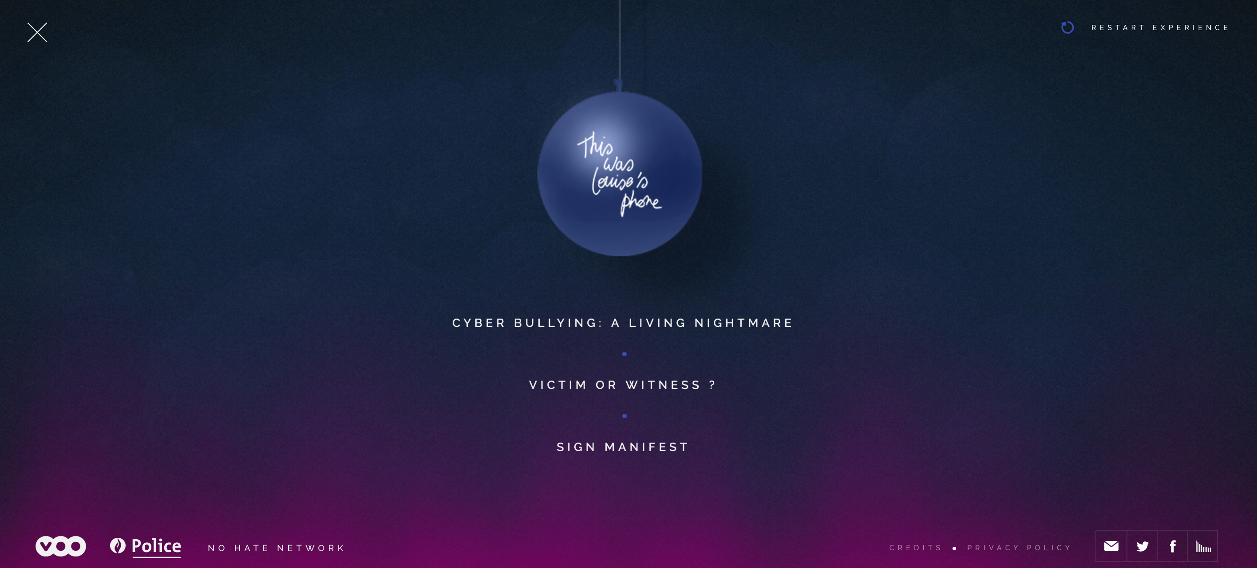
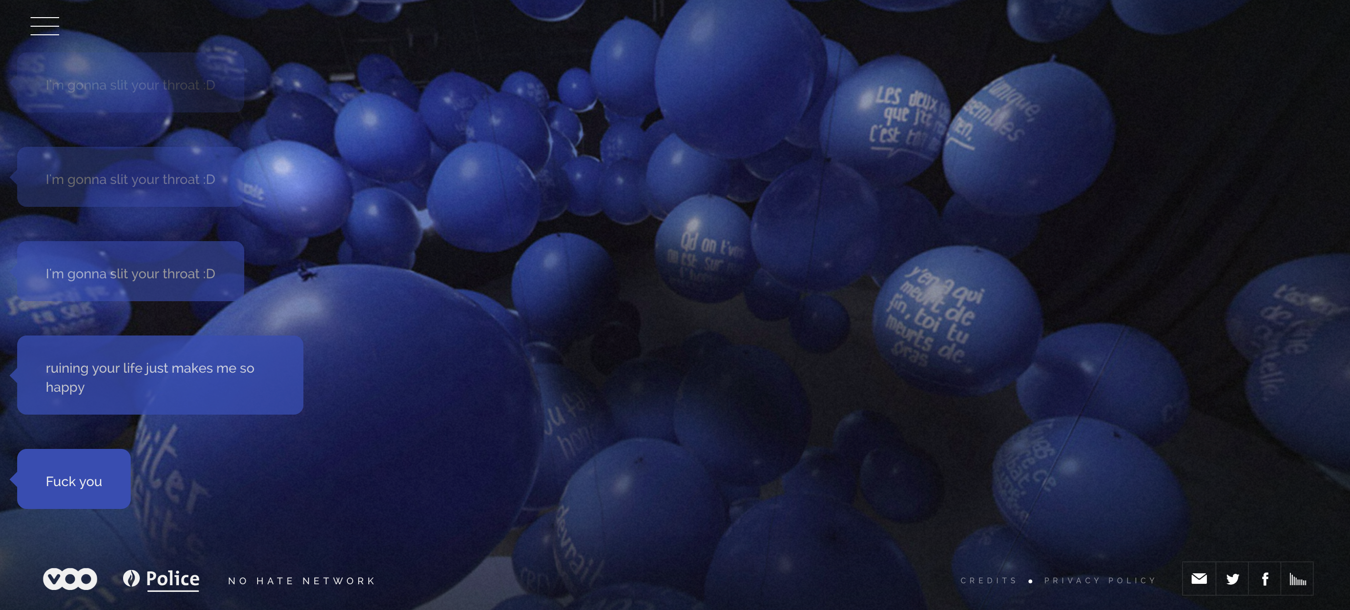

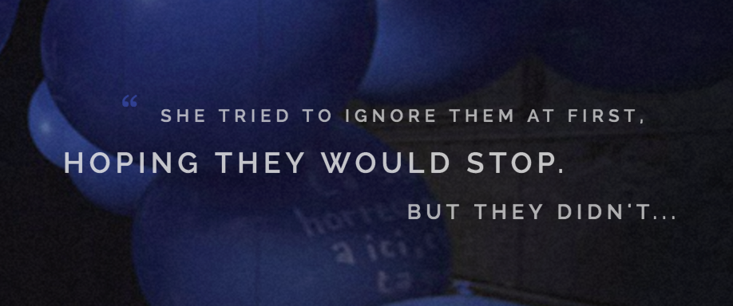
This Was Louise’s Phone
Database viewer / experience portraying the hell of cyber bullying
The user interacts with the space to experience cyber bullying and follows a narrative
Hauntingly real aspects immerse the user in the experience

Slide 6
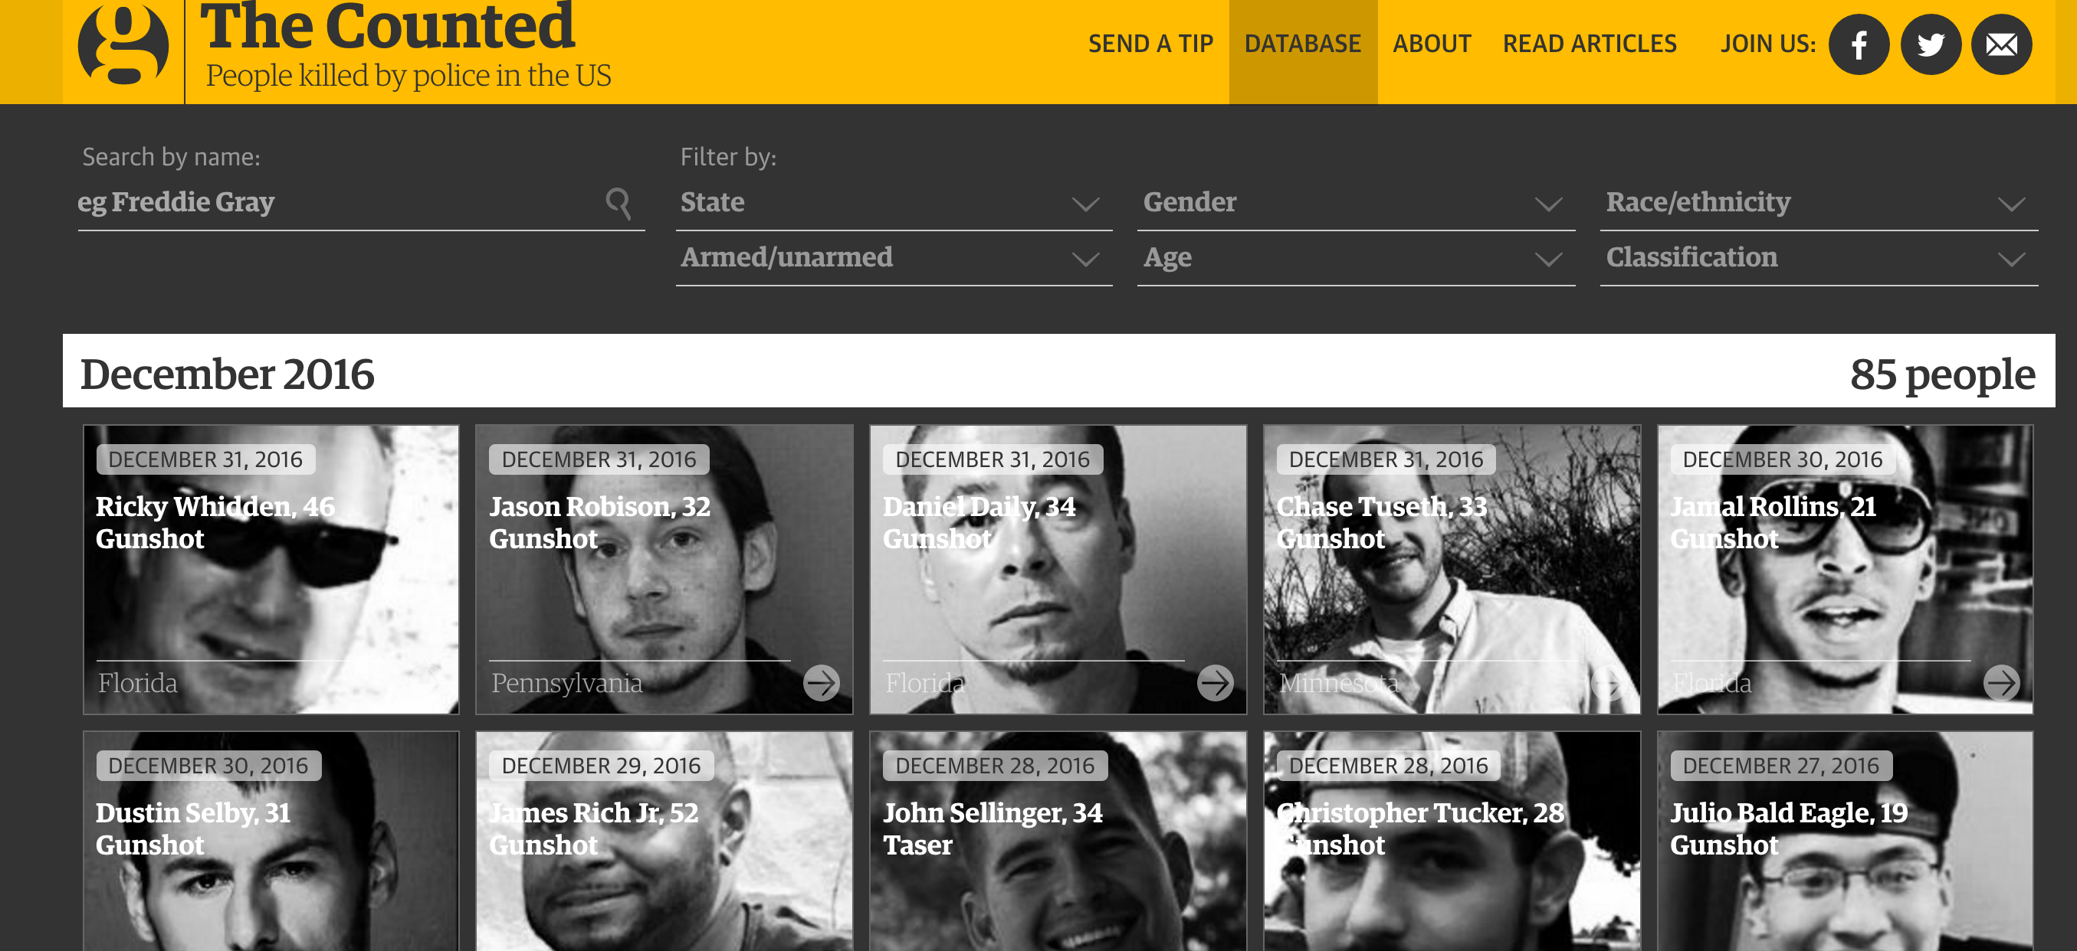
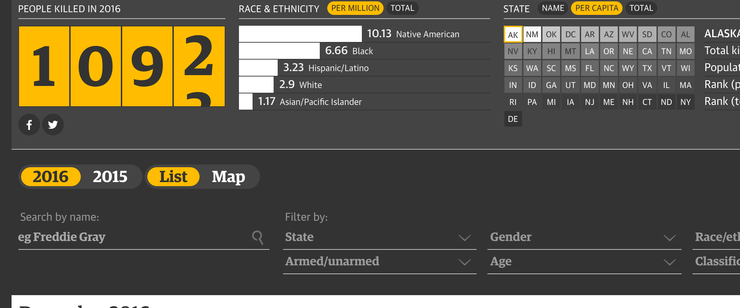
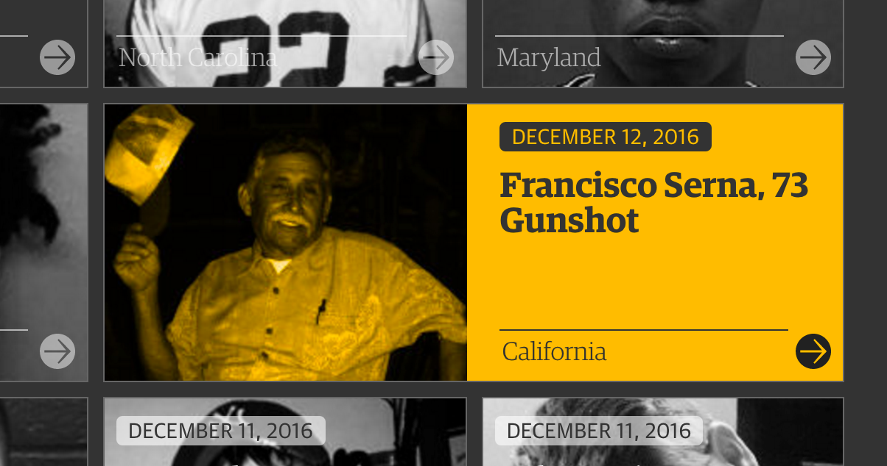
The Counted
Database viewer of people killed by police
The interface features a profile system for each person among “the counted”
This project focuses on similar aspects of the victims lives to the ones we were considering

Slide 7
The Concept

Slide 8
Stalking in the US
Interactive experience where the user is made to “stalk” in order to explore the database
Multiple viewing modes with varying complexity
Profile system detailing key info about each victim and the specifics of their stalking experience

Slide 9
Possible Viewing Modes

Slide 10
Stalker Option 1
Entirely black screen with names of victims floating in space
Proximity of cursor to name dictates opacity and visibility of the name
The user would be forced to hunt down each person or profile similar to how a stalker spies and investigates his victims.

Slide 11
Stalker Option 2
Landscape of stalkers point of viewed ; in which most aspects are blurred except of the shape of the joined circles of a binocular.
The cursor acts as the binoculars and the proximity of cursor to different key items brings its details into focus.

Slide 12
List Option
Organized list view with search features
Designed for ease of access / use and the ability to quickly reference the database
The user would quickly be able to see the profiles and info about each victim at a glance

Slide 13
Potential Considered Variables

Slide 14
Each victim profile could contain
Name
Age
Place of residence
Gender
Duration of stalking
Location of stalking
Occupation

Slide 15
Each victim profile could contain (cont.)
Was there a confrontation?
Did the victim survive?
Was the stalker caught?
A brief paragraph outlining the incident details in narrative form.
An image of the victim
What initiated the stalking?

Slide 16
User Scenario

Slide 17
Jon is interested in exploring stalking
He begins by entering the stalker view of the database where he is presented with a blank screen and a simple interface with filters and navigational components. As he moves his cursor around he notices faintly glowing names that grow brighter as his cursor draws nearer to them

Slide 18
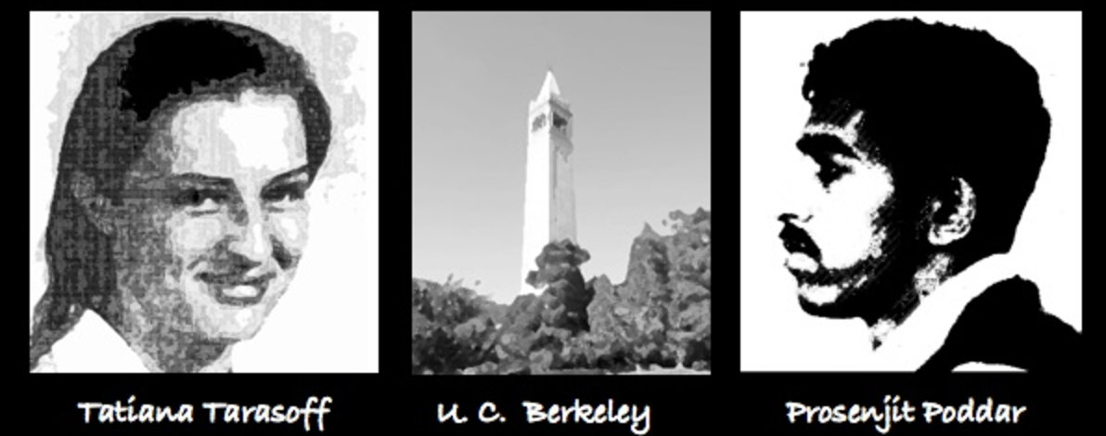
He clicks on a name and is presented with the victim profile that shows all of the relevant info about Tatiana Tarisoff and her infamous encounter with a stalker
He clicks on a name and is presented with the victim profile that shows all of the relevant info about Tatiana Tarisoff and her infamous encounter with a stalker

Slide 19
Further investigation reveals details and info such as the location of the stalking. In this case, it is U.C. Berkeley

